Slide 1

Strategic Insights: Competitive Analysis
By,
Shakira
Nafiya
Rakeek
19-11-2024

Slide 2
Introduction to Competitive Analysis
In today’s rapidly evolving market landscape, understanding competitive dynamics is crucial for staying ahead. This project focuses on a comprehensive Competitive Analysis conducted for Zephyr Technologies. By leveraging advanced data analytics tools and methodologies, we explored market trends, identified key competitors, and analyzed their strategies to uncover actionable insights.
The objective was to provide a clear understanding of Zephyr Technologies' positioning within the industry and recommend data-driven strategies to enhance its competitive edge. This analysis serves as a strategic guide to inform decision-making and drive business success.

Slide 3

Market Overview
Industry Trends
The technology education industry is experiencing rapid growth due to the increasing demand for upskilling in fields like Data Science, AI & ML, Cybersecurity, and Full Stack Development.
Growth Potential
The global e-learning market is expected to grow at a 14% CAGR over the next five years, highlighting the immense opportunity for institutes offering online and hybrid courses.
Target Audience
Students and Graduates: Looking for skill-based training to enhance employability in tech-driven roles.
Working Professionals, Corporate Clients, Freelancers and Entrepreneurs.

Slide 4
Eye Q Dot Net
Strengths:
Offers a focused 6-month Cybersecurity Internship Course with flexible installment payment options.
Small batch sizes (10 students) for personalized learning.
Provides both online and offline classes with recorded sessions for flexibility.
Placement support with successful student placement history.
Weaknesses:
Limited internship options for non-college students.
Less comprehensive marketing and social media engagement compared to others.
Clean Code
Strengths:
Specializes in SAP training with strong placement support and job portals.
Small class sizes (5 students) for interactive learning.
Recognized for quality training with multiple industry awards.
Weaknesses:
Limited staffing; lacks front desk support.
Focus on SAP may limit its appeal to broader tech learners.

Slide 5
Codelab Systems
Strengths:
Hands-on learning through live client projects, including international collaborations.
Affordable monthly pricing model.
Job assistance with referrals to companies' post-internship.
Weaknesses:
Congested facilities and limited classroom space.
Lack of branding visibility and community engagement.
G-Tech Computer Education
Strengths:
Wide range of courses, including Full Stack Development, Data Analytics, and Power BI.
Large, well-equipped classrooms with strong placement support for long-term courses.
Discounts offered through a scratch card system.
Weaknesses:
No online or hybrid course options, limiting accessibility.
Placement support not provided for short-term courses.

Slide 6
IPCS Global
Strengths:
Personalized, one-on-one training with flexible schedules for working professionals.
Global certifications and strong placement assistance.
Wide variety of courses, including Data Science and Industrial Automation.
Weaknesses:
Moderate social media presence and branding.
Lacks focus on community engagement and events.
Micro Degree
Strengths:
Affordable, flexible online courses with Kannada-language sessions for regional inclusivity.
Strong online presence with high social media engagement.
Weekly mock interviews and internships for practical learning.
Weaknesses:
Limited in-person options; entirely online format may not suit all learners.
No advanced facilities due to the virtual-only model.

Slide 7
Sree Sankaracharya Computer Center
Strengths:
Offers practical, hands-on training in fields like AI, Digital Marketing, and Generative AI.
Paid internships (₹12,000-₹20,000/month) for select courses.
Provides practical training certificates and job-role-based skill development.
Weaknesses:
Relatively high course fees for AI and Generative AI programs.
Limited branding and online presence, reducing visibility.
Octa Wave Technology
Strengths:
Affordable short-term courses in Data Analytics, Full Stack Python/Django, and Data Science.
Emphasizes placement assistance with direct company referrals.
Flexible online and offline learning options.
Weaknesses:
Limited infrastructure and classroom facilities.
Lack of advanced teaching tools and student engagement initiatives.

Slide 8
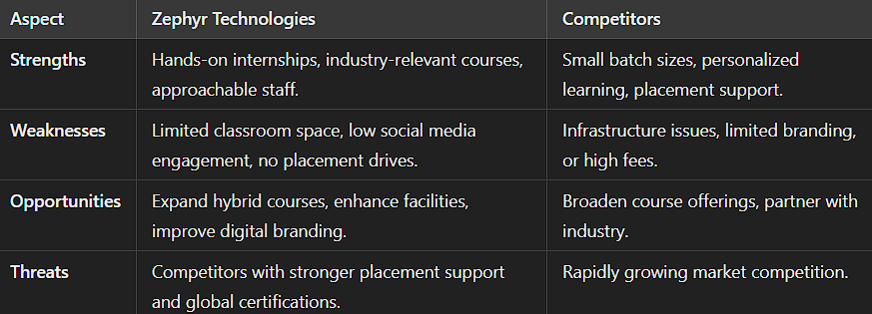
SWOT Analysis Table

Slide 9
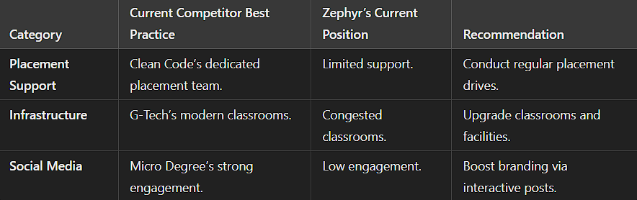
Recommendations Table

Slide 10
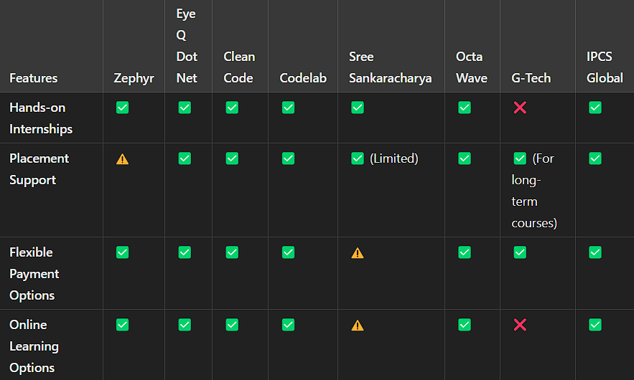
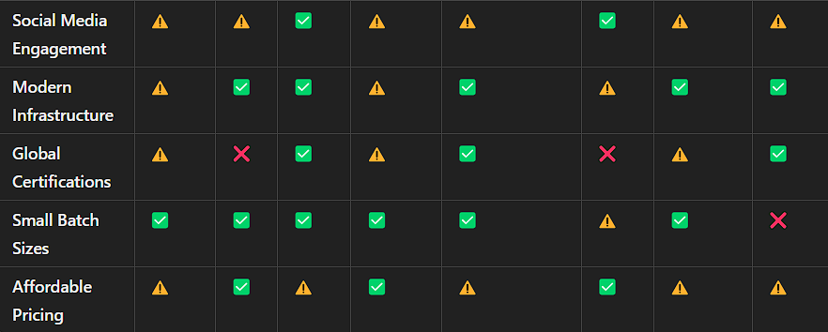
Competitor Feature Matrix

Slide 11
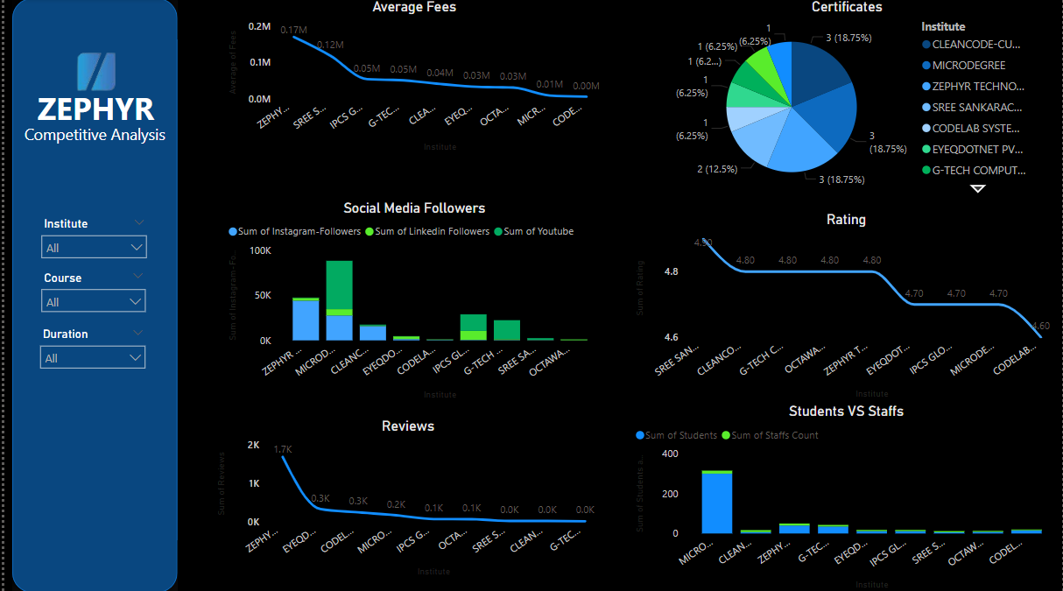
Data Insights

Slide 12
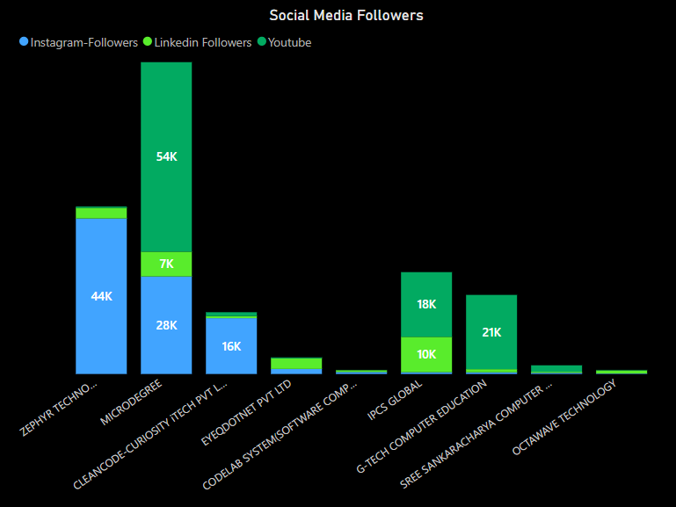
Social Media Analysis
The chart highlights the social media presence of various institutes, showcasing their follower distribution across Instagram, LinkedIn, and YouTube. Micro-Degree stands out with a dominant YouTube following, while Zephyr Technologies excels on Instagram. CleanCode-Curiosity IT maintains a balanced presence across platforms, and IPCS Global has a notable YouTube reach. Other institutes, like Eye Q dot Net and Octa-Wave Technology, show relatively lower engagement. This analysis provides insights into competitors' digital outreach strategies.

Slide 13
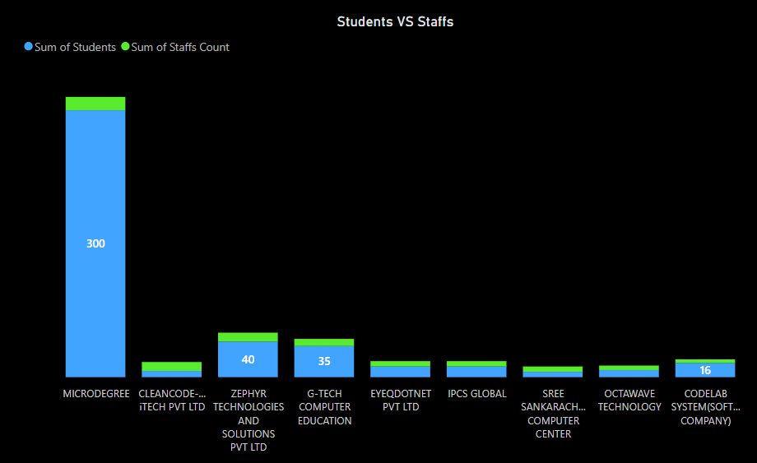
Staffs And Students Analysis
The chart compares the number of students and staff across various institutes. Micro-Degree has the highest number of students, significantly surpassing other institutes, with a proportional staff count. G tec and Zephyr Technologies follow, showing a balanced ratio of students to staff. Most other institutes, including CleanCode and IPCS Global, have comparatively smaller student and staff numbers. This analysis highlights Micro-Degree’s dominance in student enrollment and resource allocation among competitors.

Slide 14
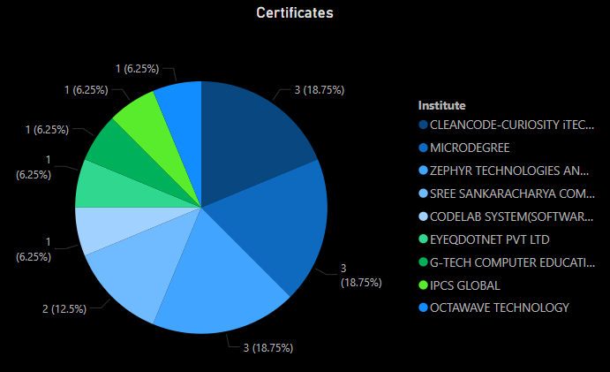
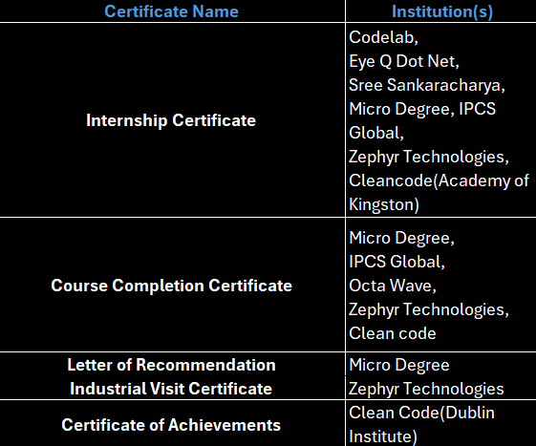
Certifications Provided

Slide 15
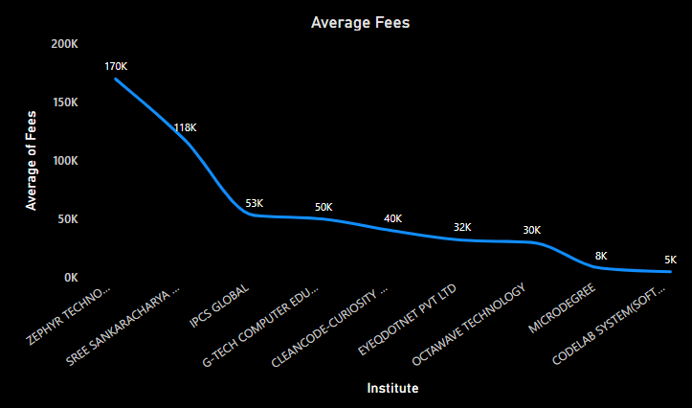
Fees Analysis
This chart compares the average fees of various institutes, showcasing significant variations. Zephyr Techno charges the highest fee of 170K, followed by Sree Sankaracharya at 118K, indicating premium pricing compared to others. In contrast, Micro degree and Codelab System software offer the lowest fees at 8K and 5K, respectively, making them highly affordable. The mid-range institutes, such as G-Tech Computer Edu and CleanCode-Curiosity, charge between 50K and 53K, offering a balance between affordability and value. Overall, the chart highlights a steep fee disparity, suggesting a wide spectrum of options for prospective learners based on budget and preferences.

Slide 16
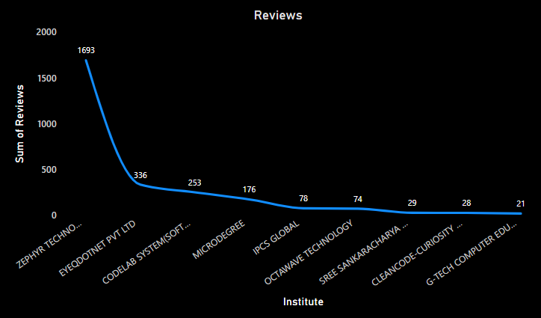
Google Review
This chart illustrates the comparative number of reviews across various institutes, highlighting their relative popularity or customer engagement. Zephyr Technology leads significantly with 1,693 reviews, suggesting a strong market presence and high engagement. Eye q dot net Pvt Ltd and Codelab System software follow with 336 and 253 reviews, respectively, indicating moderate visibility. Micro Degree and IPCS Global are in the mid-range with 176 and 78 reviews, while institutes like CleanCode-Curiosity and G-Tech Computer have minimal reviews, reflecting lower engagement levels. This disparity underscores varied levels of market reach and customer feedback among competitors in the industry.

Slide 17
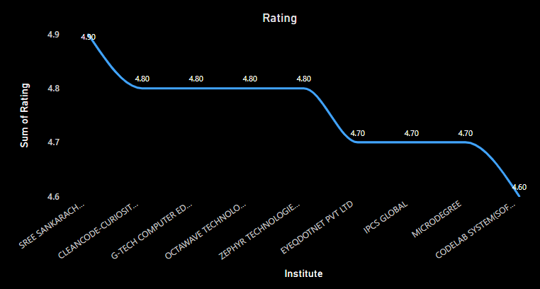
Google Rating
This chart compares the ratings of various institutes, showcasing customer satisfaction levels. Sree Sankaracharya and CleanCode-Curiosity lead with the highest rating of 4.90, indicating exceptional customer approval. A cluster of institutes, including G-Tech Computer Edu, Octa-Wave Technology, and Zephyr Technology, maintain a consistent rating of 4.80, reflecting solid performance. Ratings for Eye Q dot net Pvt Ltd, IPCS Global, and Micro-Degree drop slightly to 4.70, while Codelab System software has the lowest rating at 4.60. These ratings reveal a relatively narrow range of satisfaction, suggesting strong competition in maintaining high service quality among the institutes.

Slide 18
Recommendation
Strengths
Atmosphere & Facilities: The institute provides a good atmosphere and theme, though space optimization and better-arranged classrooms would enhance the student experience.
Pricing and Teaching Strategies: Current strategies are well-received, but targeted enhancements could improve
Placement and Career Support: Competitors like IPCS Global and Clean Code Institute offer strong placement assistance, including mock interviews, exclusive job portals, and direct referrals. Zephyr should prioritize connecting students with placement drives, job fairs, and partnerships with companies, as job outcomes are a key motivator for learners.
Content Quality: Eye Q.net emphasizes professional-grade video content, avoiding quantity over quality. Similarly, Zephyr should focus on producing high-quality, engaging, and professional learning materials, as these directly impact credibility.
Marketing and Social Media: Competitors such as Micro-Degree and IPCS Global leverage social media and student success stories for branding. Highlighting placement successes, student projects, and testimonials could boost Zephyr’s market visibility.

Slide 19
Recommendation
Space and Classroom Design: G-Tech Education sets a high standard with spacious and well-organized classrooms. Enhancing classroom design could improve the learning environment for Zephyr’s students. Actionable Suggestions
Enhance Video and Online Content: Focus on professional-grade instructional videos engaging tutorials like clean code institute. Share real-time success stories of student placements or projects on social platforms to increase credibility. Improve Facility
Standards: Reorganize and optimize classroom spaces to foster a professional and comfortable atmosphere.
Student-Centric Initiatives: Establish peer learning groups and alumni networks to encourage community engagement. Provide post-course support, including resume building and career counseling.

Slide 20
Recommendation
Improve classroom infrastructure and expand space.
Conduct placement drives and build stronger industry connections.
Increase social media engagement through interactive posts, webinars, and success stories.
Introduce hybrid learning models (online + offline).
Offer unique certifications or exclusive partnerships with tech companies.
Next Steps for Zephyr
Focus Areas: Enhance placement support, improve infrastructure, and offer globally recognized certifications.
Actionable Goals: Develop a competitive pricing strategy and boost branding efforts through interactive marketing campaigns.
Build Industry Relations and Collaborations: Create a dedicated business development team to forge new industry ties and partnerships.
Increase International Presence and Reach: Expand Zephyr’s presence by offering online courses to international students.

Slide 21
Challenges and Opportunities for Zephyr Technologies
Challenges
Market Competition
Limitation: The education sector is crowded with local and global players offering similar programs.
Impact: Zephyr must differentiate itself to attract top-tier students and employers.
Adapting to Rapid Technological Changes
Limitation: Keeping the curriculum updated with emerging technologies is resource-intensive.
Impact: Outdated courses may fail to meet industry needs.
Infrastructure and Scalability
Limitation: Scaling infrastructure for growing demand, especially for hands-on training, is challenging.
Impact: Difficulty in scaling may affect the quality of training.
Opportunities
Leveraging Emerging Technologies
Opportunity: Offer courses on AI, Machine Learning, Blockchain, and Cloud Computing.
Impact: Positions Zephyr as a leader in tech education, attracting future-focused students.
Building Strategic Partnerships
Opportunity: Partner with global tech companies, universities, and certification bodies.
Impact: Enhances credibility, attracts top faculty, and improves global placements.
Developing an Online Learning Platform
Opportunity: Expand online courses with flexible schedules.
Impact: Increases enrollment, reduces geographical barriers, and diversifies the student base.

Slide 22

Conclusion
In conclusion, the competitive analysis of various institutes in the educational technology and training industry has provided invaluable insights into the strengths and weaknesses of the key players. While many competitors excel in personalized learning, placement support, and practical, hands-on experience, common weaknesses such as limited course variety, infrastructure challenges, and weak branding provide Zephyr Technologies with a strategic advantage to lead the market.
By focusing on expanding our course offerings with high-demand programs like Generative AI, enhancing our infrastructure, and investing in modern teaching tools, Zephyr can not only meet but exceed industry expectations. Furthermore, strengthening our placement support, increasing our digital presence, and offering flexible learning options will ensure we cater to the diverse needs of today’s students and professionals.
Zephyr Technologies has the unique opportunity to rise above the competition by combining innovation, flexibility, and unparalleled student support. By leveraging these strengths, we can position ourselves as a leader in tech education, driving future success for both our students and the organization.
With a strong focus on differentiation and continuous improvement, Zephyr Technologies is poised for significant growth and industry leadership in the ever-evolving landscape of tech education.

Slide 23
Thanks!
Any Questions?

